Slide 1
Introduction to Dart (Chapter 1 and 2)
Youssef N Altherwy

Slide 2
Chapter 1: Hello, Dart!
Object Oriented Language
Developed By Google in 2011
Primarily used for building websites, servers, and mobile apps
Provides libraries, an editor, a virtual machine (VM) and a compiler to JavaScript
DartPad is an online editor used to program and compile Dart codes
.dart is the extension of dart files

Slide 3
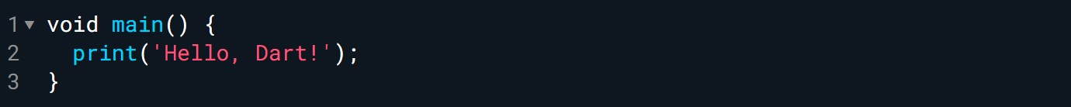
Sample Code
Dart program starts from the main function

Slide 4
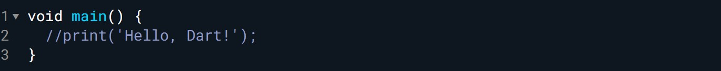
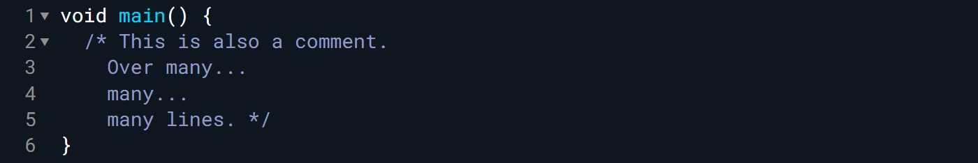
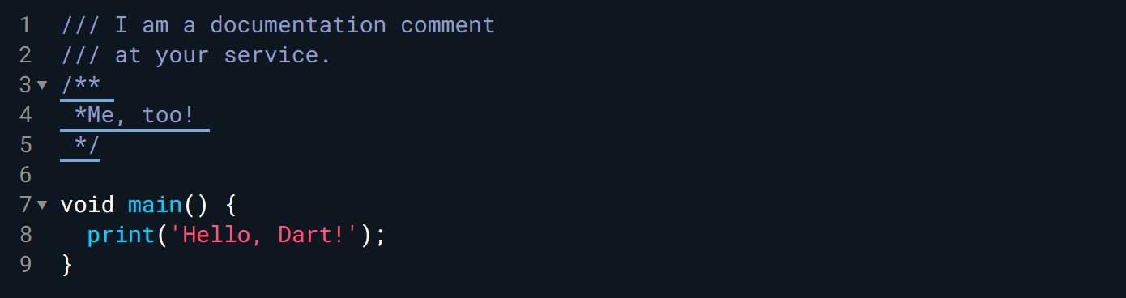
Chapter 2: Expressions, Variables & Constants
Commenting the codes
Single line
Multiple lines
Documentation comments (for writing documentation, supports Markdown)

Slide 5
Statements and Expressions
In Dart, all simple statements end with a semicolon(;)
An expression is a value or is something that can be calculated as a value.
42
3 + 2
‘ Hello World’
Statement
Expressions

Slide 6
Arthematic Operations
Operation | Expression | Example | Results
Addition | + | 3 + 2 | 5
Subtraction | - | 3 - 1 | 2
Multiplication | * | 3 * 2 | 6
Division | / | 3/2 | 1.5
truncating division operator (Integer Division) | ~/ | 3/2 | 1
Modulo | % | 3 % 2 | 1

Slide 7
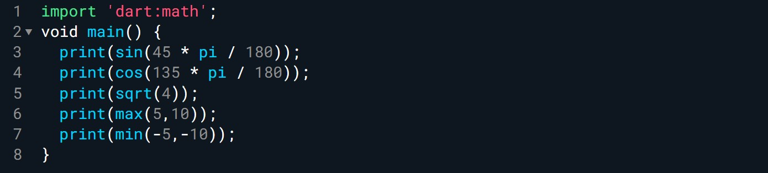
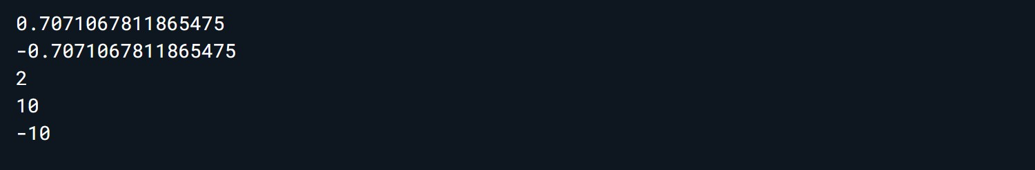
Math Functions
Import statement is necessary
Example of a math function
Results

Slide 8
Math Functions
Mini-exercise
In the example before you found the sine of 45° by first converting 45° to radians and then using the Dart sin function, which works in radians, to calculate the result. Now print the value of 1 over the square root of 2 in Dart. Confirm that it equals the sine of 45°.

Slide 9
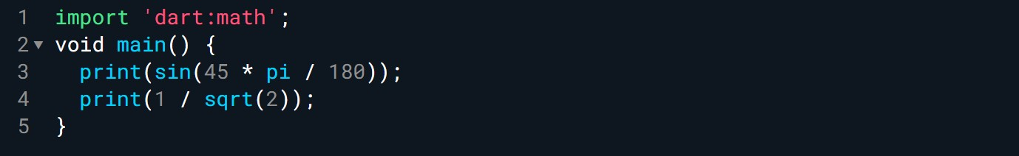
Math Functions
Solution

Slide 10
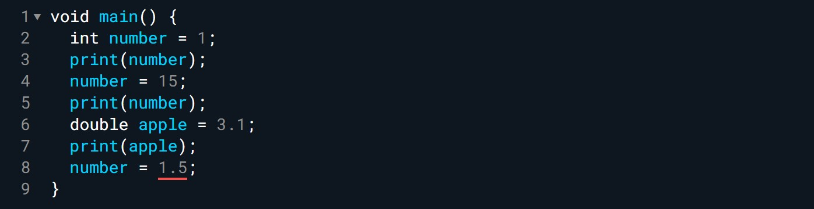

Naming Data
Variables
Error because number is int not double.
This is called type-safety
Results

Slide 11
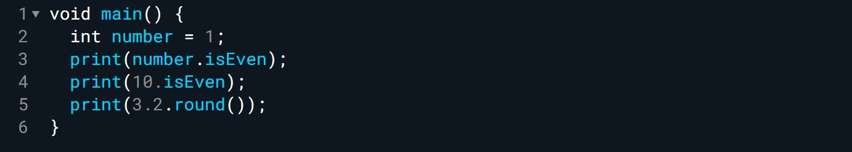
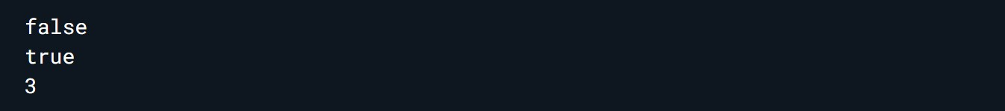
Naming Data
Everything in Dart is an object
Results

Slide 12
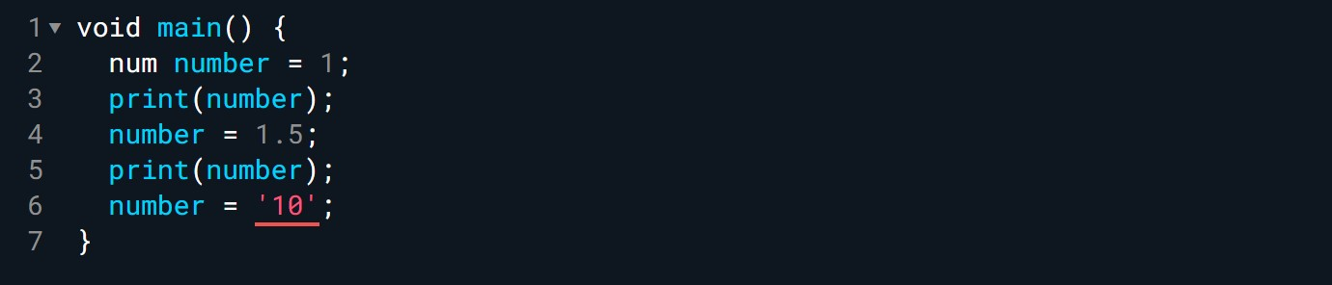
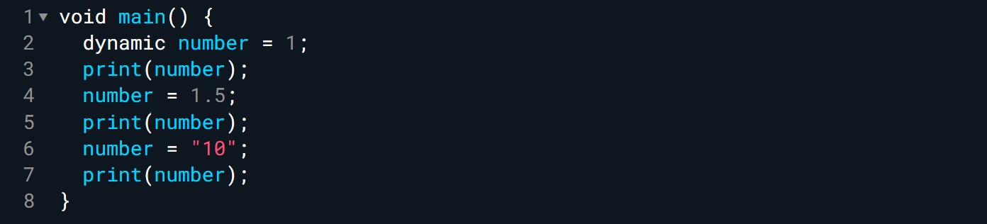

Naming Data
num type
dynamic type
num is both int and double
Still error because type-safety
Results
dynamic accepts everything and
don’t care about type-safety.
Don’t use it!!
Results

Slide 13
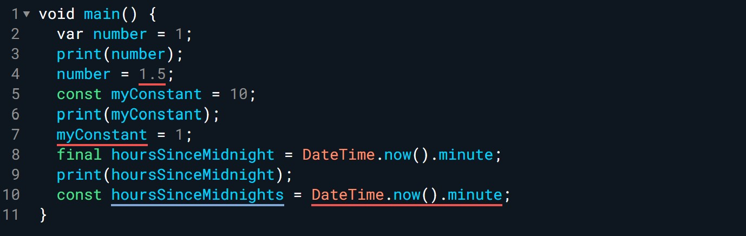

Naming Data
var lets the compiler decides on the type of the variable
Still error because type-safety
const type is for compile-time constants
Error because const cannot be changed
final type is for runtime constant
Error because the value changes in runtime
Results

Slide 14
Naming Data
Mini-exercises
1. Declare a constant of type int called myAge and set it to your age.
2. Declare a variable of type double called averageAge. Initially, set the variable to your own age. Then, set it to the average of your age and your friend’s age.
3. Create a constant called testNumber and initialize it with whatever integer you’d like. Next, create another constant called evenOdd and set it equal to testNumber modulo 2. Now change testNumber to various numbers. What do you notice about evenOdd?

Slide 15
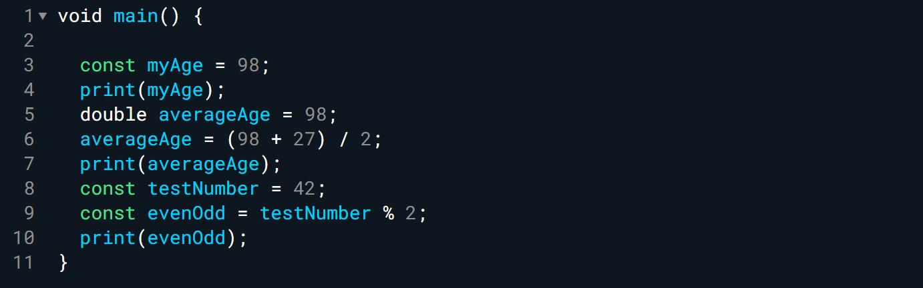

Naming Data
Solution
Results

Slide 16
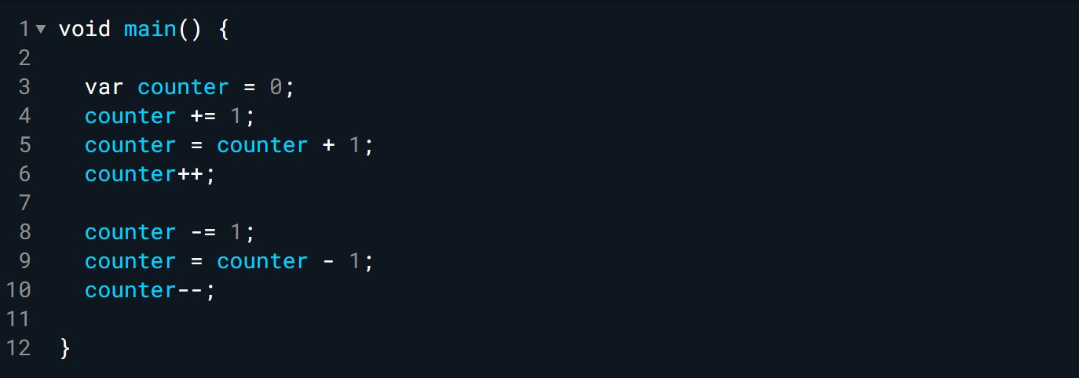
Increment and Decrement
Similar
Similar

Slide 17
Increment and Decrement
Mini-exercises
Write a program to
1. Multiply two floating point variables and print the result. The values are 2.5 and 6.1
2. Calculate the square of the result from step 1 and print the result.
3. Increment the result from step 2 by 1 and decrement the result from step 1 by 1. Print both values.
4. Finally, swap the the two values from step 3 and print the results. (e.g., put the first value in the second variable and vice versa)

Slide 18
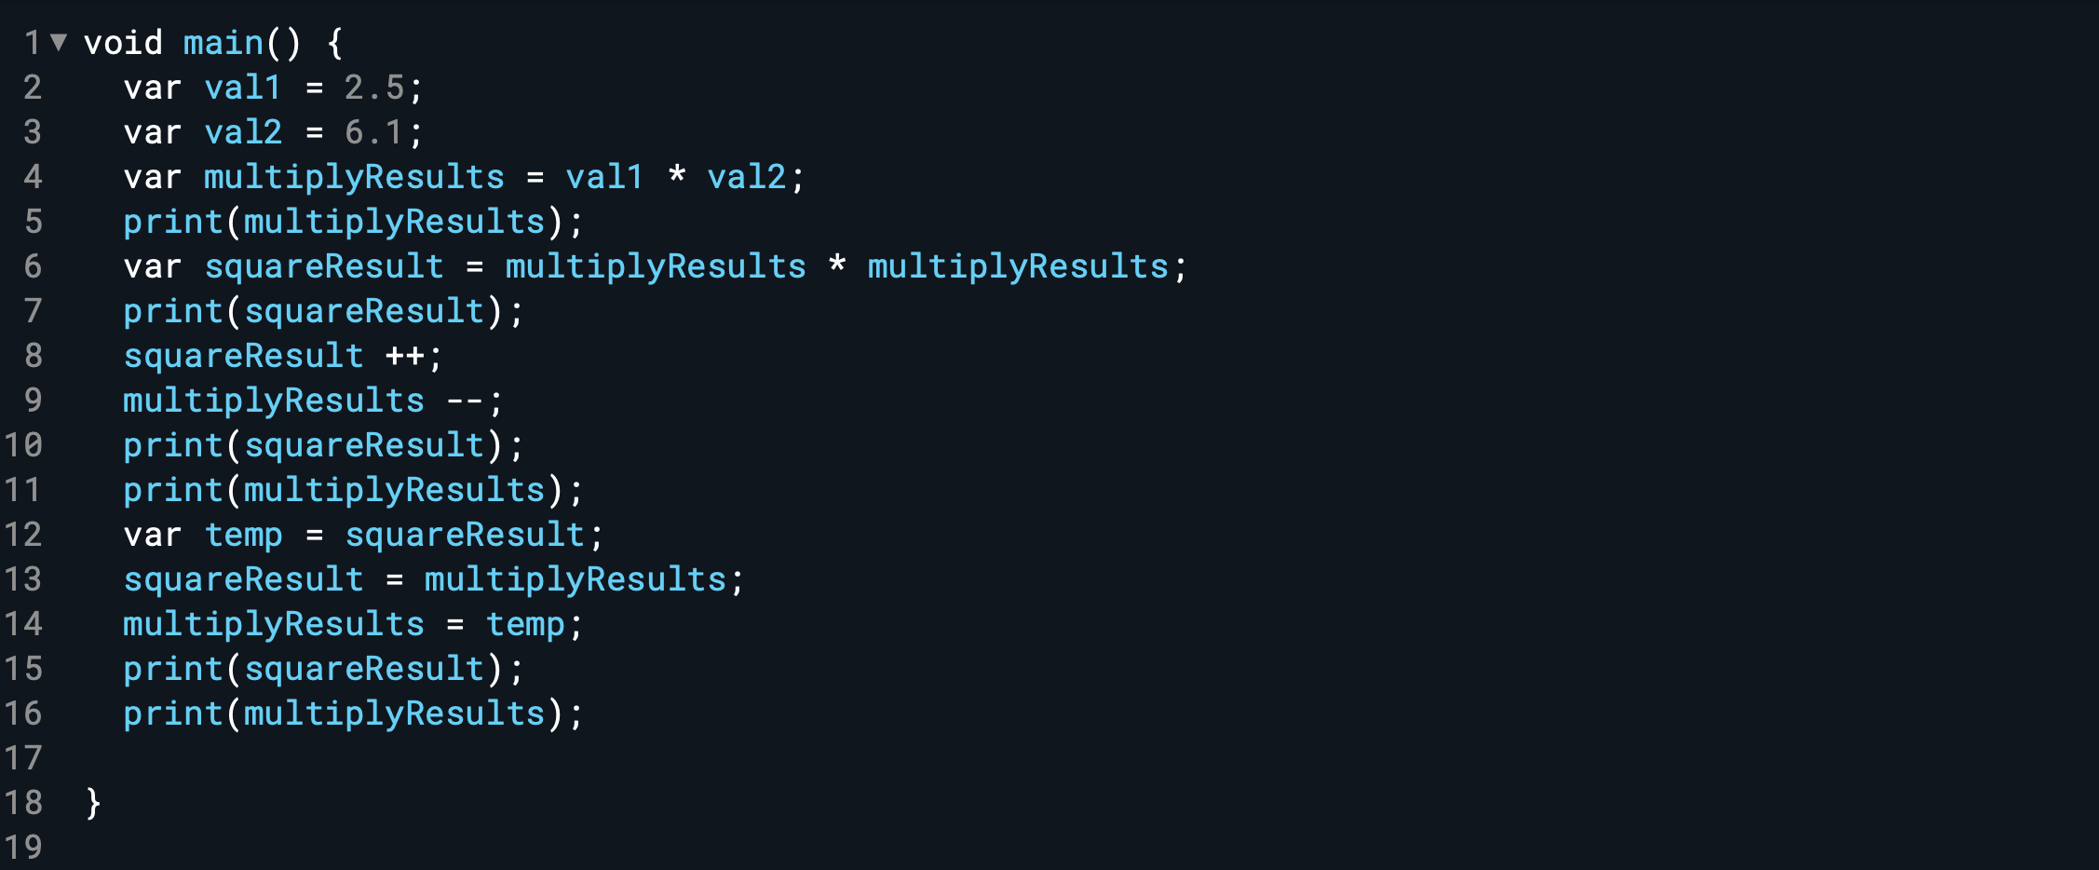

Increment and Decrement
Solution
Results

